Slide 1

Weekly Review
04/05/21
Tasks
Solve NaN problem (Root-cause : Entropy definition) 🗸
Make original repository run on Gaming Machine (Mujoco standalone license) X
Problems
To-Do Items for Next Week
Get robust implementation on cloth_corner experiment
Test cloth_sewts experiment
cloth_corner experiment
Mujoco environments running
dm_control environment gives fatal error
Original implementation (rlpyt)
SAC Implementation
Custom implementation (dm_control)
Define entropy and tune parameters
cloth_sewts experiment
Experiment for
pre-manipulation
Test on whichever implementation gives better result for cloth_corner environment

Slide 2
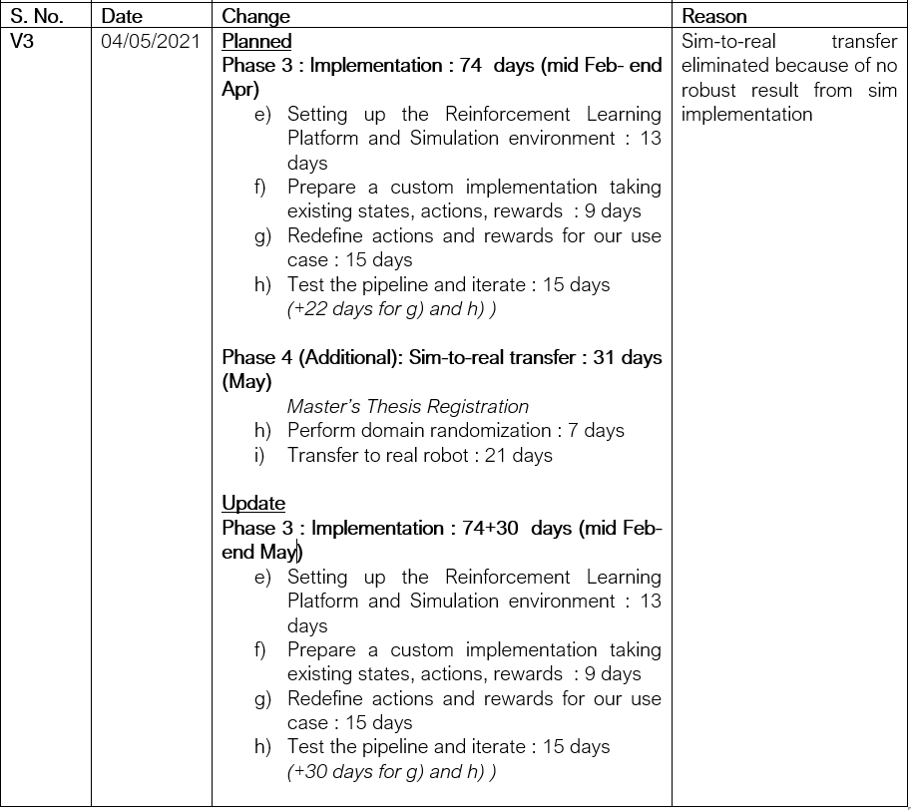
Plan update
04/05/21

Slide 3
THANK YOU

